Slide 1

Talend ESB
Module Code : ESB01
By : Muhammad Faris Ashim

Slide 2
About the Instructor
{
name : "Muhammad Faris Ashim",
status : "Online" ,
description : "Software Engineer+System Analyst, 9 (nine) years experiences in System & Application Development"
}
4

Slide 3
Agenda
Define ESB and application integration
Explore ESB capabilities vs. Data Integration capabilities
Identify the main ESB features
Describe a mediation route use case
Describe a simple ESB reference infrastructure
4

Slide 4


Enterprise Service Bus
Introduction to ESB
5

Slide 5



What is Application Integration?
HR
In the Cloud
Shipping
Enterprise Service Bus
ERP
CRM
ERP
CRM
HR
Shipping
On Premises
Point to point only works for small numbers of applications
Integrations become costly to maintain and more fragile and brittle over time
Applications connected using service interfaces through a common bus
Resulting architecture becomes much more agile and flexible

Slide 6
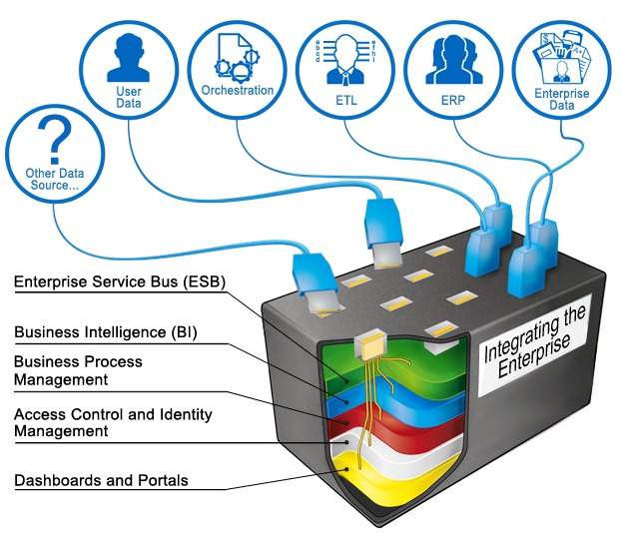
ESB Analogy

Slide 7
ESB concepts
ESB stands for Enterprise Service Bus
Refers to the concepts and tools that allow different heterogeneous applications in the information system to exchange messages via standard formats

Slide 8
ESB concepts, continued
Mediation layer in SOA (Service Oriented Architecture) implementations. The ESB supports all of its standards and allows developers to create web services
As a layer on SOA, the ESB adds routing abilites to:
Process application messages as soon as they are issued
Define a pattern to process and redirect messages to other applications
Event-driven architecture is determined by events such as user actions (mouse clicks, key presses), sensor outputs, or messages from other programs or threads

Slide 9
SOA (Service Oriented Architecture) Defined
To an IT professional, SOA integrates all your systems, so that different programs and applications, all from different vendors and running on different machines, can communicate smoothly and effectively. This also means that your legacy infrastructures can coexist with your new cloud services.
To a business executive, SOA creates a more competitive business edge by improving the efficiency of collaboration between business processes and IT. SOA drives growth by boosting productivity, enhancing performance and eliminating frustrations with IT.

Slide 10


Service-Oriented Architecture
Businesses Need Agility & Reuse
Service Consumers
Benefits
Dramatically
Increase
Business Agility
APIs
Reusable Business
Components
Easily orchestrate
new business
processes
Reusable Services
Deliver Reusable
Services that
outlive applications
Payment Mgmt
Services
Credit
Check
Fraud
Detection
Access
Service
Interest
Calc
Balance
Check
Customer
Data
Services
Trade
Execution
Cloud
Insulate users
from changes in IT
Partner
Credit Data
Back-end System
Back-end System
Customer
Data

Slide 11
Bottom Line of SOA
Integrates with current infrastructure
Decrease development costs
Better scalability
Reduce maintenance and support costs

Slide 12
ESB vs. DI
How to choose between ESB and DI tools Use DI Jobs when:
Processing big batches of data
The main purpose is to transform data
The process can be scheduled and does not need real-time action

Slide 13
ESB vs. DI, continued
How do you choose between ESB and DI tools? Use ESB routes or data services when:
Processing single messages or single requests
The main purpose is to react to a defined event
Incoming messages or requests should trigger an action in real time

Slide 14
The Talend Solution for Application Integration

Slide 15


Talend Application Integration
Development team
Operations Team
Benefits
Design
Deploy
Manage
Increases
Productivity
Talend ESB
Built In
Data Quality
Data
Services
Security
Services
Identity
Services
Data Quality
Services
Studio
APIs
Supports team
development
Enterprise Service Bus Runtime Container, Service Governance, Message Broker
Extensive
Connectivity
Connectors
External
Data Sources
ERP
CRM
Legacy
Systems
Cloud
Apps
Select Icons made by Freepik, Situ Herrera, www.flaticon.com

Slide 16
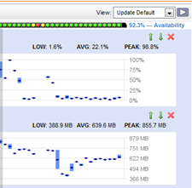
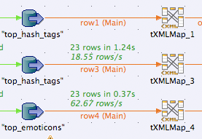





Talend Application Integration Only Integration Solution for Data, Applications and Processes
Graphical design of REST/Web services
800+ Pre-built connectors including Hadoop
Supports Enterprise Integration Patterns
Design
Test directly from within Talend Studio
Support for functional & load testing
Visualize end-to-end flow simulation
0101010110101010101010101011010101010101010101010101010101010101011010101010101010101010110101010101010101011010101010101011010101010101010101011010101010101
Extend
Test
r
Data Services and SOA
Identity Mgmt. Services
Big Data ready, IoT, Mobile
Manage
Deploy
On-premises, cloud and hybrid
Distributed lightweight ESB
Policy driven enterprise security
Centralized monitoring & alerting
Fault tolerant, scalable and flexible
Consistent infrastructure

Slide 17
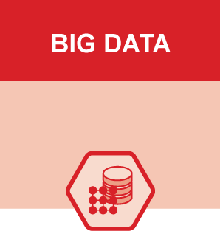

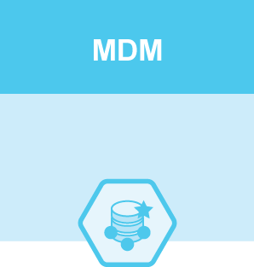
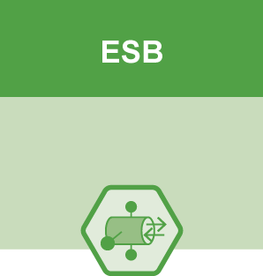
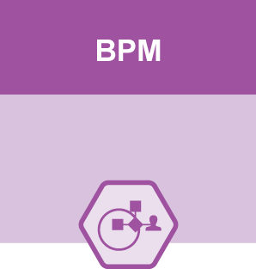

Talend ESB Product Family
Built on Apache and provides real-time connectivity in many Talend solutions
Big Data
Data Management
Master Data Management
Data Services
Enterprise Integration
Talend Platforms
Enterprise bundles
Advanced features
ESB
Talend Enterprise ESB
Commercial
Subscription
Talend Open
Studio for ESB
Talend ESB Runtime
+
Talend Studio
Open source
Free of charge
Apache
Projects
CXF / Karaf
Camel
ActiveMQ
Industry leading
Standards based
Service Enablement
Integration Framework
Message Broker

Slide 18

Simplify Application Integration
Makes it easy to implement a services based infrastructure with rapid development, IT flexibility and business agility
Lower Total Cost of Ownership
Extensive library of pre-built connectors
Predictable pricing and 40% reduction in maintenance time
Leverage existing resources
$
Faster time to market
Increased productivity 30% with a single tool for design, test and deployment
Enables a converged integration strategy of data & application integration
Rapidly configure and enforce security through policies
Avoid vendor lock in
Based on open source software
Standards based
Works with existing IT infrastructure
Big Data Ready

Slide 19
Talend ESB Basics
Building Simple Mediation Routes with Apache Camel

Slide 20

ESB routes and data services
Talend Studio allows developers to develop application integration programs called routes and data services

Slide 21
ESB routes
Talend routes are programs designed to catch messages on the information system and route (redirect) them to a destination defined by a set of rules and transformations
Unlike Talend Jobs, routes are not supposed to end once deployed. Routes are event-driven programs, which means they keep scanning the information system for events and react in real time when they detect one

Slide 22

ESB routes: example
This is a consumer endpoint.
Consider it an antenna or sensor: it listens in at a particular place in your ESB system. It is configured to catch a specific type of event.

Slide 23
ESB routes: example, continued
This consumer endpoint is configured to listen to an FTP server and catch any new text file from the ./catalogue folder

Slide 24

ESB routes: example, continued
A new text file is created on the FTP server in the
./catalogue folder

Slide 25





ESB routes: example, continued
The endpoint catches the event

Slide 26

ESB routes: example, continued
The endpoint sends a message-- the content of the file--to a route: a predetermined set of rules and transformations, and, finally, a destination

Slide 27
ESB routes: example, continued
The message is processed so that the text data is formatted in XML

Slide 28
ESB routes: example, continued
The message is then sent to its final destination (in this example, ActiveMQ)

Slide 29

Building mediation routes
Talend Studio helps developers build routes with graphical components. It then generates the corresponding code to build the routes
Mediation routes are generated by using the Apache Camel routing engine framework

Slide 30
Building mediation routes
An Apache Camel route contains the following elements:
Components provide the interface to connect to other sources or systems (file, HTTP, JMS). They handle connectivity, drivers, and protocols
Processors handle actions between components. They can transform, enrich, validate, intercept, and even reroute messages
Routes are sequences that wire components and processors together

Slide 31
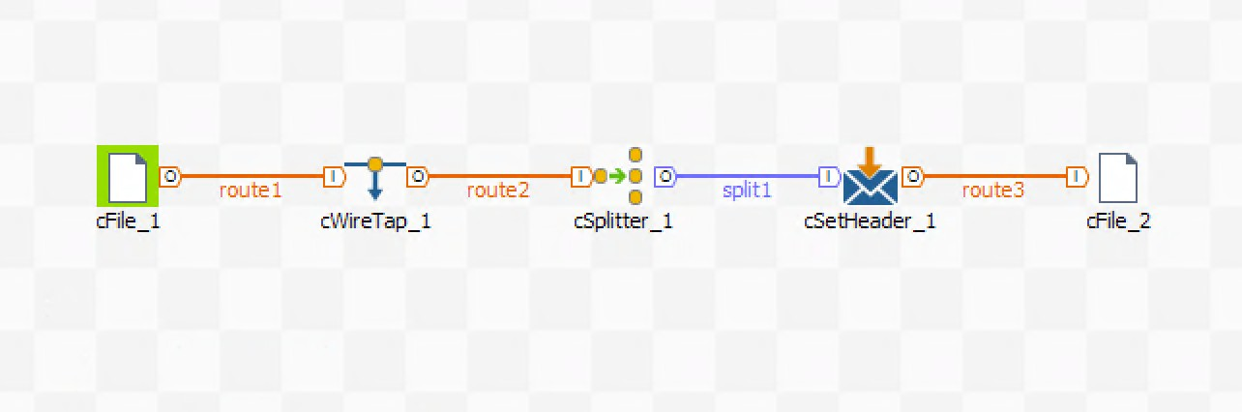
Building mediation routes: example
Components
Route
Processors

Slide 32
Endpoints
Unlike DI components, ESB (Apache Camel) components can be used as input or output for any route
In this example, the file component reads a file when placed at the beginning of the route, and it writes a file when placed at the end of the route

Slide 33
Endpoints, continued
Components placed at the beginning and end of a route are called endpoints
Endpoint
Endpoint

Slide 34
Endpoints, continued
The endpoint at the beginning of a route is in charge of intercepting an event and sending it into the route for processing
This endpoint is called a consumer endpoint, as it consumes any event it is programmed to catch
Consumer endpoint
Endpoint

Slide 35
Endpoints, continued
The endpoint at the end of a route is in charge of sending the processed message out of the route
This endpoint is called a producer endpoint, as it produces an event on the interface that its component is configured to use
Consumer endpoint
Producer endpoint

Slide 36
Endpoints, continued
When the consumer endpoint catches an event, it converts it to a message
The message follows the route--the defined sequence of processors--until it reaches the producer endpoint
consumer endpoint
producer endpoint

Slide 37
Endpoints, continued
When the message reaches the producer endpoint, it exits the route via the interface defined in the producer endpoint component
Consumer endpoint
Producer endpoint

Slide 38
Lab overview
In this lab, you will:
Create your first route
Use the File component and configure it

Slide 39
Talend ESB Basics
SOAP Web Services

Slide 40
SOAP web services
SOAP web services expose operations on a server. These operations can be called remotely by sending an XML- formatted query.
The SOAP protocol usually uses HTTP as the transport layer.
All SOAP services declare a WSDL (Web Services Definition Language) file. This file defines all available operations, along with their request and response message formats.
40

Slide 41

SOAP web services: example
A Talend runtime server exposes a SOAP web service on the Internet. This service can place an order in an e-commerce system.
41

Slide 42

SOAP web services: example, continued
This web service-client machine needs to place an order by sending a request to the SOAP service
42

Slide 43
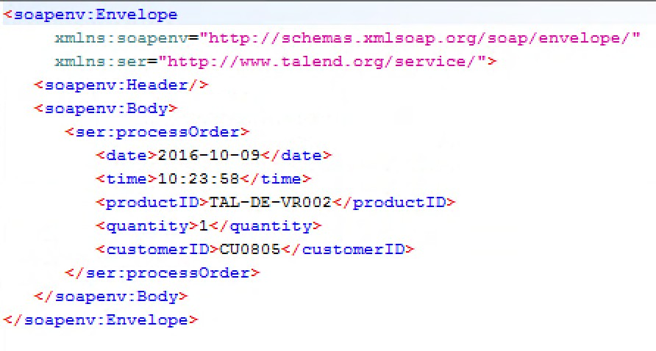
SOAP web services: example, continued
The client sends a web service request message over HTTP to the web service
43

Slide 44
SOAP web services: example, continued
The server processes the request and places the order according to the information contained in the request message
44

Slide 45
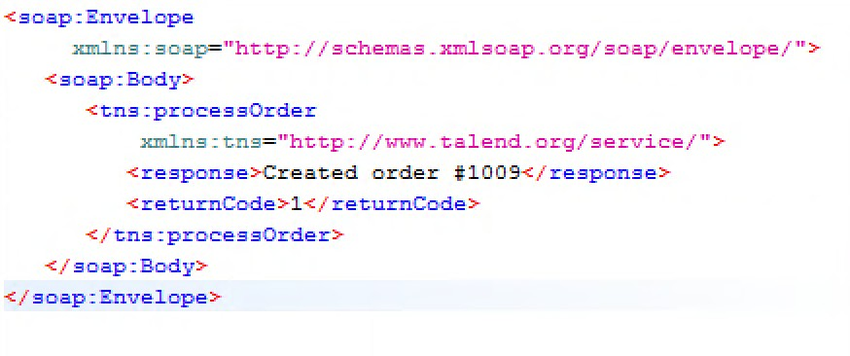
SOAP web services: example, continued
When the operation is complete, the server sends a response message to the web service client
45

Slide 46
Creating a SOAP web service
To create a SOAP web service with Talend Studio, you first need to create a WSDL file.
The WSDL file is the contract that provides a comprehensive description of your service and its properties:
How to access it
Where to access it
Which operations are available
Which formats are expected for the input (request) and the output (response)
46

Slide 47
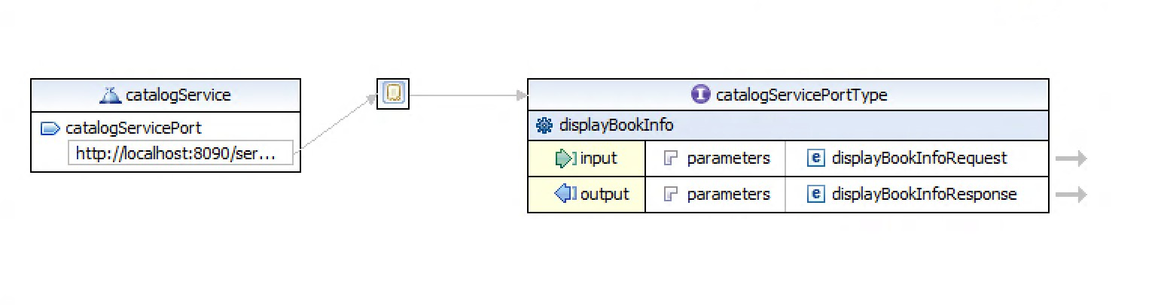
Creating a SOAP web service, continued
Port information (service access URI)
Operation definition
Input/output format definition
47

Slide 48
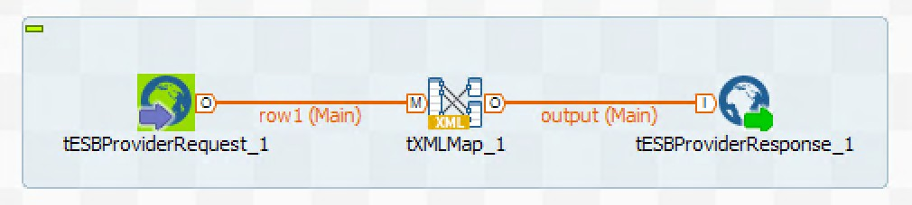
Creating a SOAP web service
Once the service's operations are defined in the WSDL, each operation can be assigned a DI Job
To be assigned to a service operation, a DI Job needs to start with SOAP web service component tESBProviderRequest and end with tESBProviderResponse
120

Slide 49
Lab overview
In this lab, you will:
Learn how to create a SOAP web service from scratch
Design a WSDL with the help of the Talend Studio GUI
Assign a Talend Job to your web service operation
Create a Job to consume your web service
Create a second SOAP web service to access a database and display information
121

Slide 50
Thank You

